Slide 1

Software Design (swD392)
Ch13 - Software Subsystem Architectural Design

Slide 2
Main Contents
General Introduction
Issues in Software Architectural Design
Integrated Communication Diagrams
Separation of Concerns in Subsystem Design
Subsystem Structuring Criteria
Decisions about Message Communication between Subsystems

Slide 3
General Introduction
During analysis modeling, the problem is analyzed by breaking it down and studying it on a UC–by–UC basis
During design modeling, the solution is synthesized by designing a software architecture that deﬁnes the structural & behavioral properties of the software system
To successfully manage the inherent complexity of a large-scale software system, it is necessary to provide an approach for decomposing the system into subsystems and developing the overall software architecture of the system. After performing this decomposition, each subsystem can then be designed independently
Notes:
Synthesized: tổng hợp
Inherent: vốn có

Slide 4
General Introduction
To design the software architecture, it is necessary to start with the analysis model. Several decisions need to be made in designing the software architecture:
Integrate the use case–based interaction models into an initial software architecture.
Determine the subsystems using separation of concerns and subsystem structuring criteria
Determine the precise type of message communication among the subsystems
Notes:
Synthesized: tổng hợp
Precise: tóm lược

Slide 5
Issues in Software Architectural Design
In the analysis of the problem domain and structuring a system into subsystems, the emphasis is on functional decomposition, such that each subsystem addresses a distinctly separate part of the system.
The design goal is for each subsystem to perform a major function that is relatively independent of the functionality provided by other subsystems.
A subsystem can be structured further into smaller subsystems, consisting of a subset of the functionality provided by the parent subsystem.
After the interface between subsystems has been deﬁned, subsystem design can proceed independently.

Slide 6
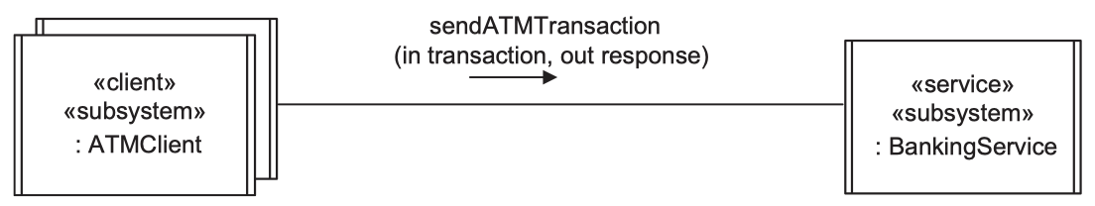
Issues in Software Architectural Design
Some subsystems can be determined relatively easily because of geographical distribution or server responsibility (client, service)
In other applications, it is not so obvious how to structure the system into subsystems. Because one of the goals of subsystem structuring is to have objects that are functionally related and highly coupled in the same subsystem, a good place to start is with the use cases. Objects that participate in the same use case are candidates to be grouped into the same subsystem
Because of this, subsystem structuring is often done after the interaction among the constituent objects of each use case has been determined during dynamic modeling

Slide 7
Integrated Communication Diagrams
Why? To transition from analysis to design and to determine the subsystems, it is necessary to synthesize an initial software design from the analysis carried out so far.
How? By integrating the UC–based interaction diagrams developed as part of the dynamic model.
What? In the analysis model, at least one communication diagram is developed for each use case. The integrated communication diagram is a synthesis of all the communication diagrams developed to support the use cases.

Slide 8
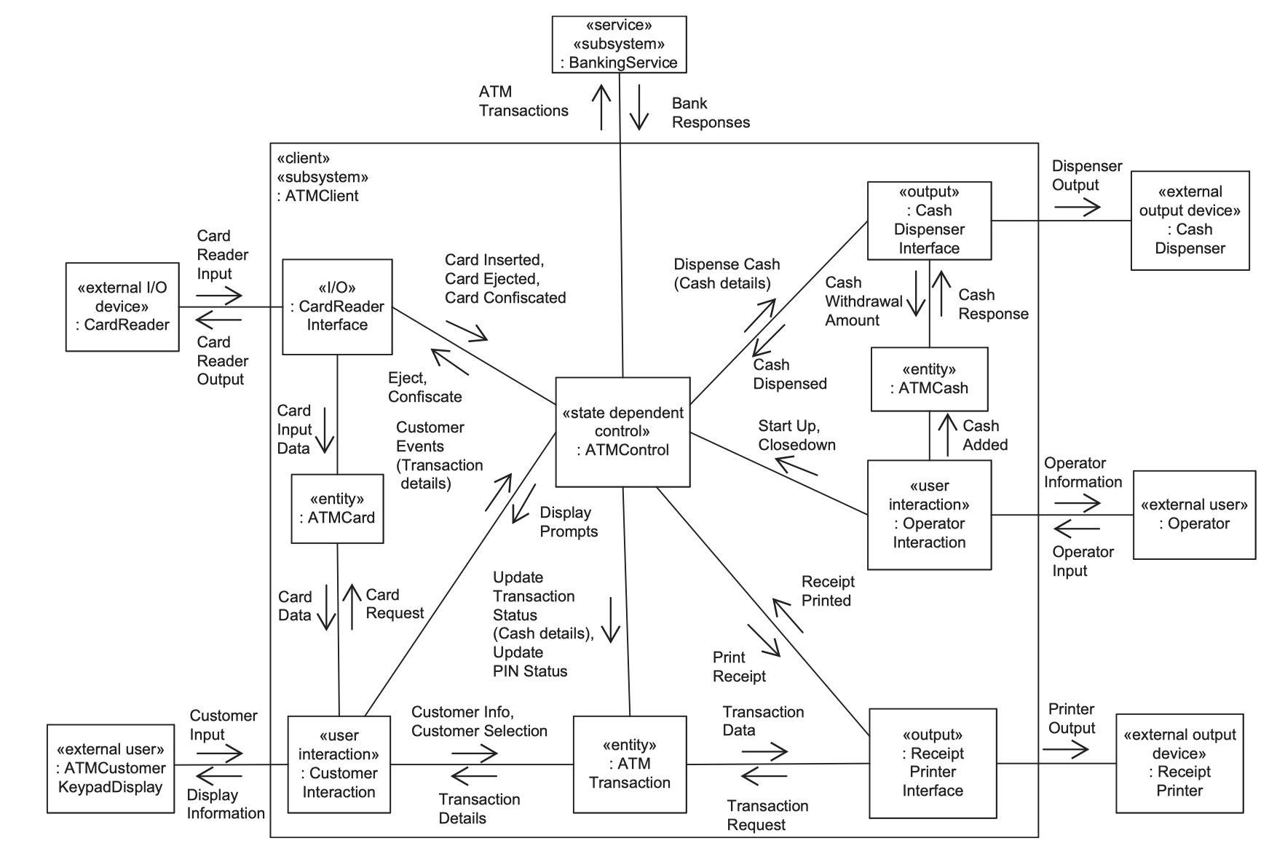
Integrated Communication Diagrams

Slide 9
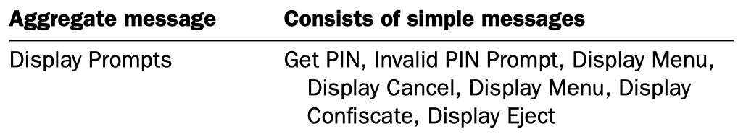
Integrated Communication Diagrams
The integrated communication diagram can get very complicated for a large system; therefore, it is necessary to have ways to reduce the amount of information
One way to reduce the amount of information on the diagram is to aggregate the messages
Furthermore, showing all the objects on one diagram might not be practical. A solution to this problem is to develop integrated communication diagrams for each subsystem and develop a higher-level subsystem communication diagram to show the interaction between the subsystems,

Slide 10
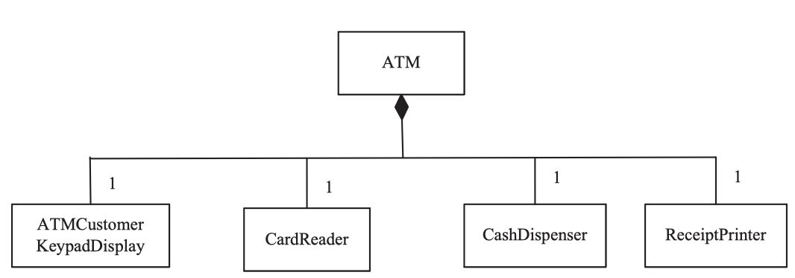
Separation of Concerns in Subsystem Design Composite Object
A composite object is typically composed of a group of related objects that work together in a coordinated fashion
Objects that are part of the same composite object should be in the same subsystem and separate from objects that are not part of the same composite object.
The composite object (the whole) and its constituent objects (the parts) are created together, live together, and die together.
ATM is the composite object, others are constituent objects

Slide 11
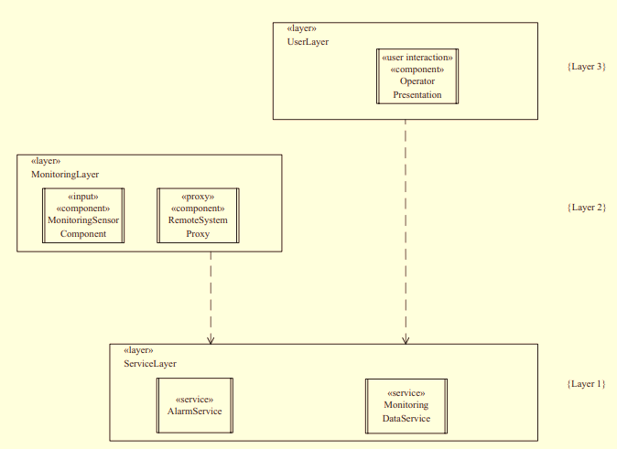
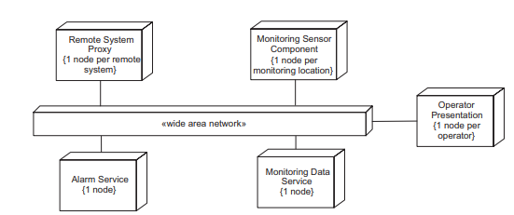
Separation of Concerns in Subsystem Design Geographical Location
If two objects could potentially be physically separated in different geographical locations, they should be in different subsystems.
In the example, the service layer is divided because the 2 services don’t related by any mean.

Slide 12
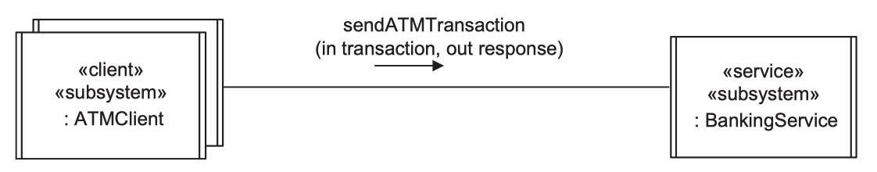
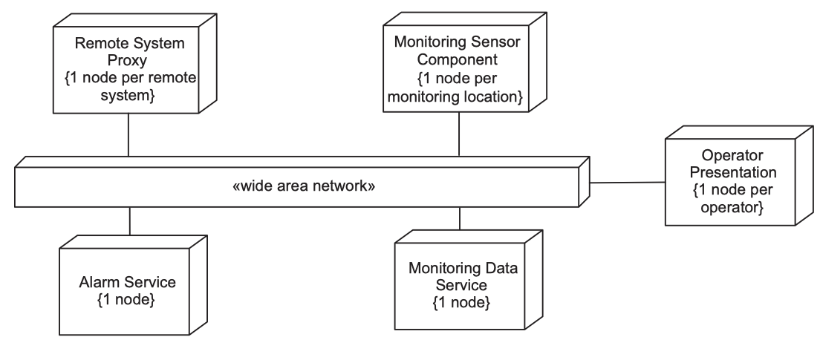
Separation of Concerns in Subsystem Design Clients and Services
Clients and services should be in separate subsystems. This guideline can be viewed as a special case of the geographical location rule because clients and services are usually at different locations

Slide 13
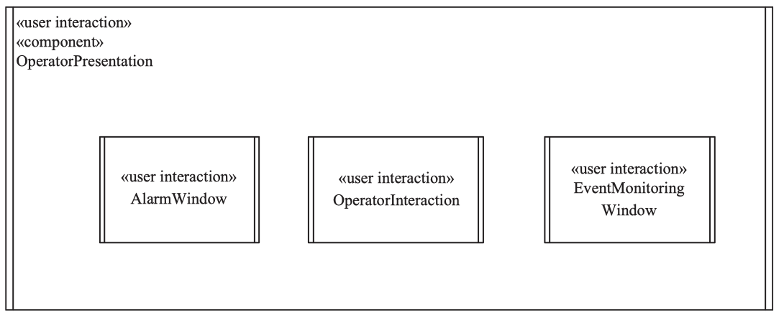
Separation of Concerns in Subsystem Design User Interaction
Users often use their own PCs as part of a larger distributed conﬁguration, so the most ﬂexible option is to keep user interaction objects in separate subsystems.
As user interaction objects are usually clients, this guideline can be viewed as a special case of the client/service guideline.
Furthermore, a user interaction object may be a composite graphical user interaction object composed of several simpler user interaction objects.

Slide 14
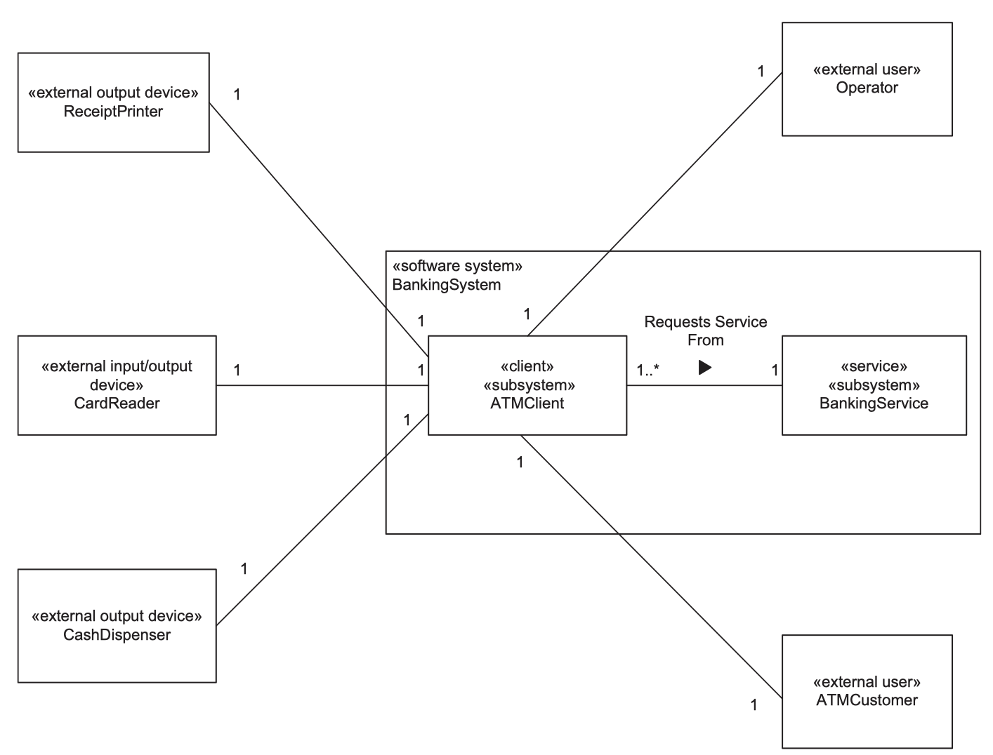
Separation of Concerns in Subsystem Design Interface to External Objects
A subsystem deals with a subset of the actors shown in the use case model and a subset of the external real-world objects shown on the context diagram. An external real-world object should interface to only one subsystem.

Slide 15
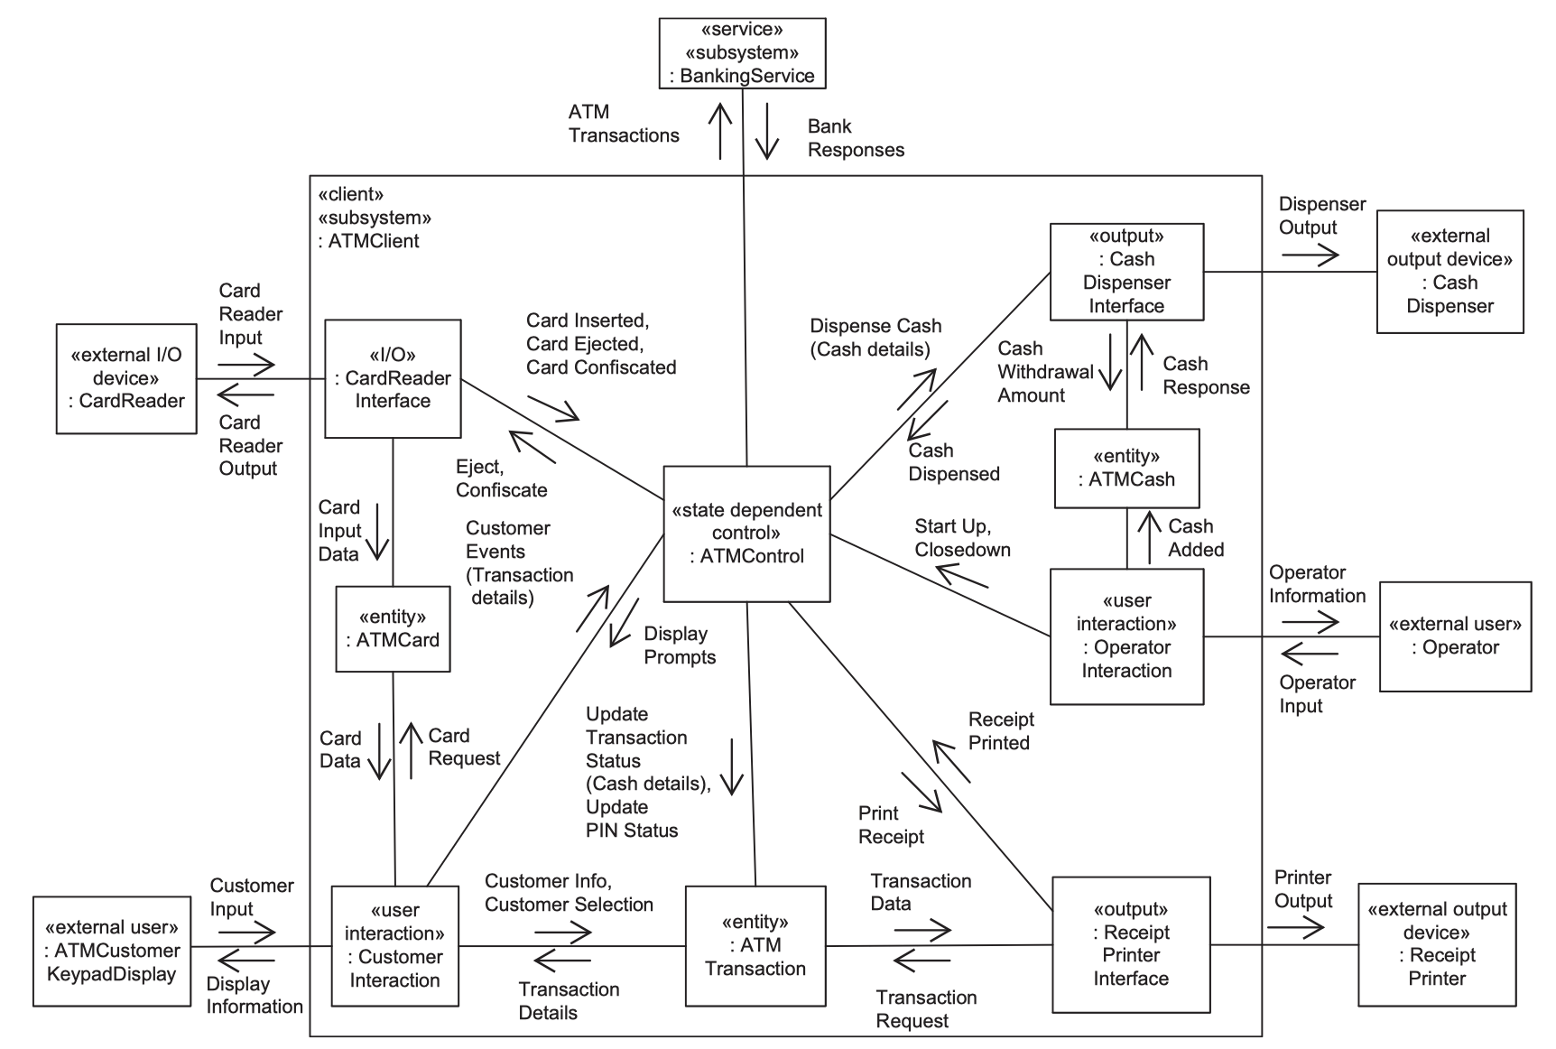
Separation of Concerns in Subsystem Design Scope of Control
A control object and all the entity and I/O objects it directly controls should all be part of one subsystem and not split among subsystems.
Notes:
The sample provides the overall control of the objects in the ATM Client subsystem, including several internal I/O objects (such as Card Reader Interface and Cash Dispenser Interface), user interaction objects (such as Customer Interaction), and entity objects (such as ATM Transaction).

Slide 16
Subsystem Structuring Criteria
The design considerations described in the previous section can be formalized as subsystem structuring criteria, which help ensure that subsystems are designed effectively.
Subsystems are generally depicted with the stereotype «subsystem». For certain software architectures consisting of distributed component-based subsystems, the stereotype «component» is used for such a subsystem, and in service-oriented architecture consisting of service subsystems, the stereotype «service» is used for a service subsystem.

Slide 17
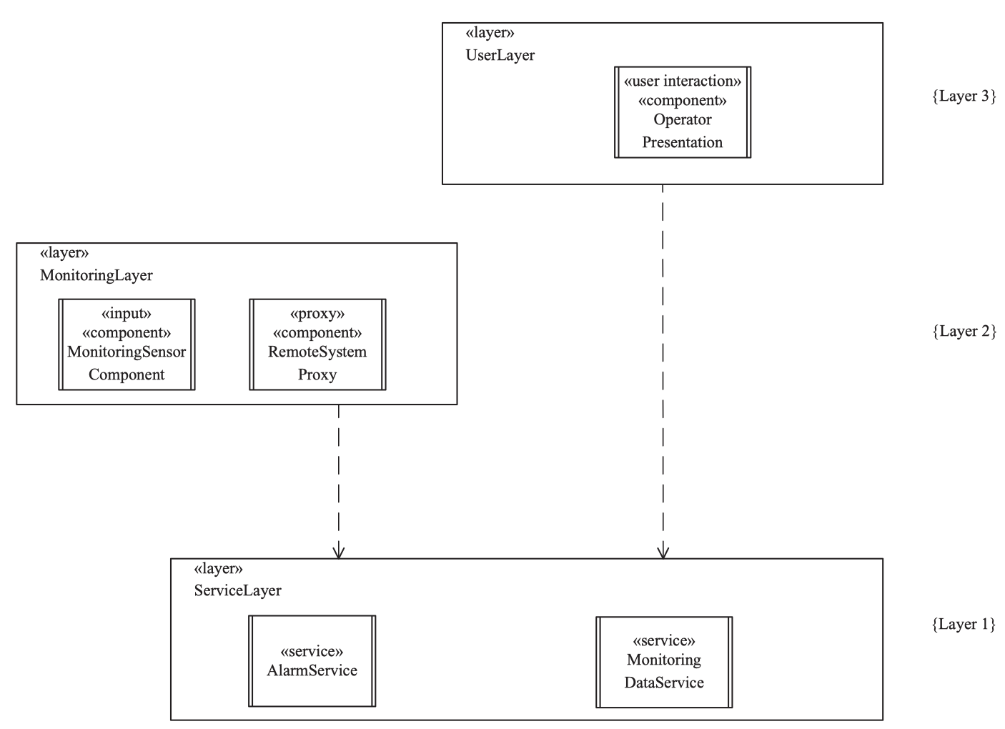
Subsystem Structuring Criteria Client Subsystem
A client subsystem is a requester of one or more services.
Client subsystems include user interaction subsystems, control subsystems, and I/O subsystems. (will be detailed later)
A client subsystem may combines more than one role.
In this example, The Monitoring Sensor Component, Remote System Proxy, and Operator Presentation components are clients of Alarm Service and Monitoring Data Service

Slide 18
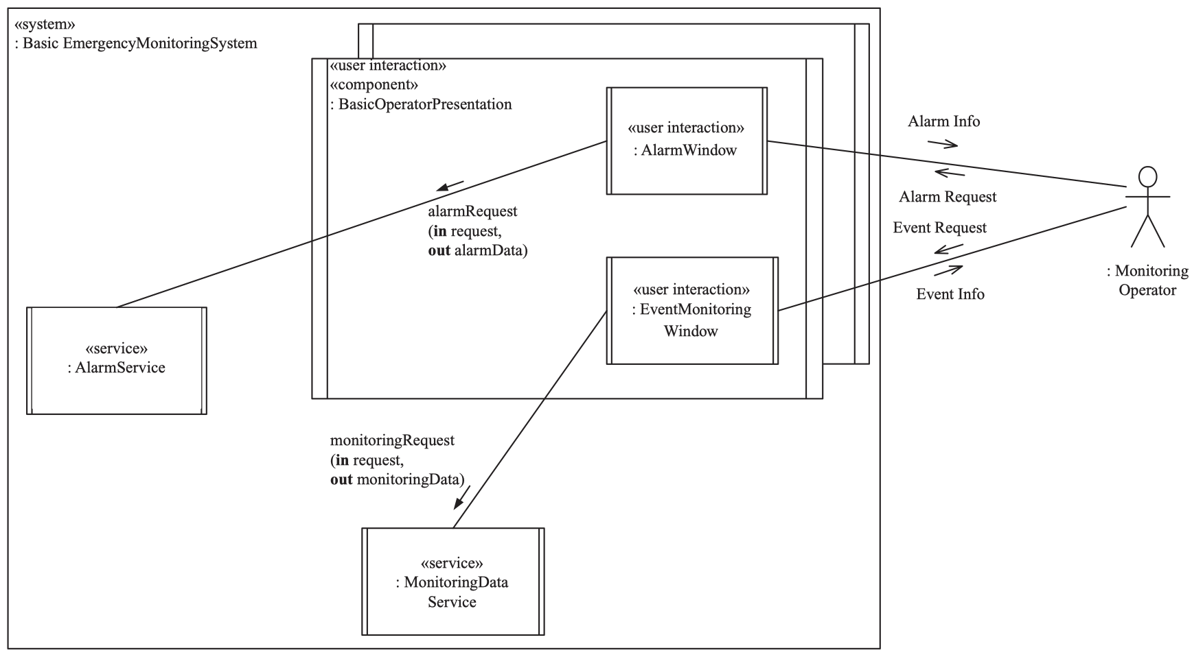
Subsystem Structuring Criteria User Interaction Subsystem
A user interaction subsystem provides the user interface and performs the role of a client in a client/server system, providing user access to services. There may be more than one user interaction subsystem – one for each type of user.
A user interaction subsystem is usually a composite object that is composed of several simpler user interaction objects.
May contain entity objects for local storage and caching, and control objects for overall sequencing of user input and output.
In this example, the Operator actor interacts with the system through two Windows of UI Subsystem

Slide 19
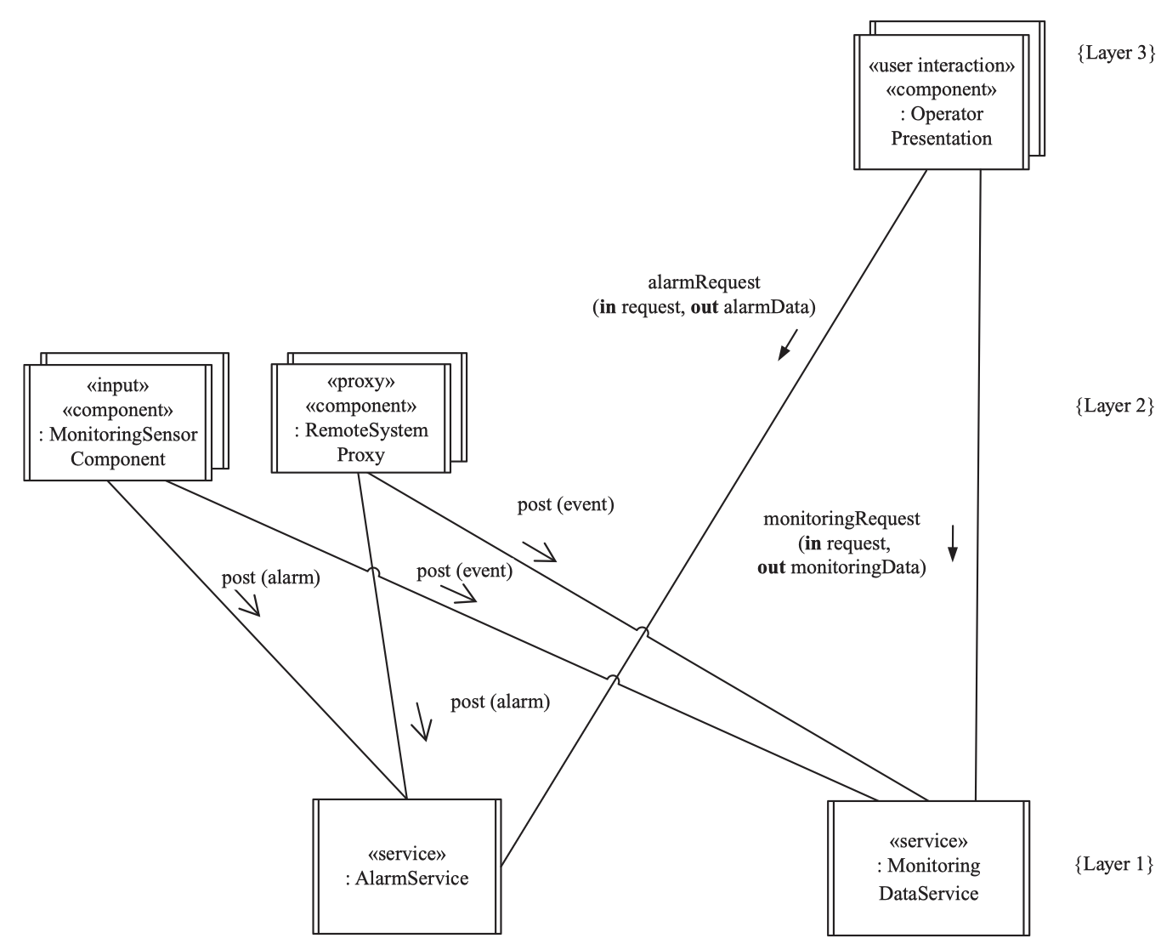
Subsystem Structuring Criteria Service Subsystem
A service subsystem provides a service for client subsystems. It responds to requests from client subsystems, although it does not initiate any requests.
Include entity objects, coordinator objects that service client requests and determine what object should be assigned to handle them, and business logic objects that encapsulate application logic.
Usually associated with a set of related data repositories to access database or I/O devices.
In this example, Alarm Service and Monitoring Data Service belong to Service Subsystem

Slide 20
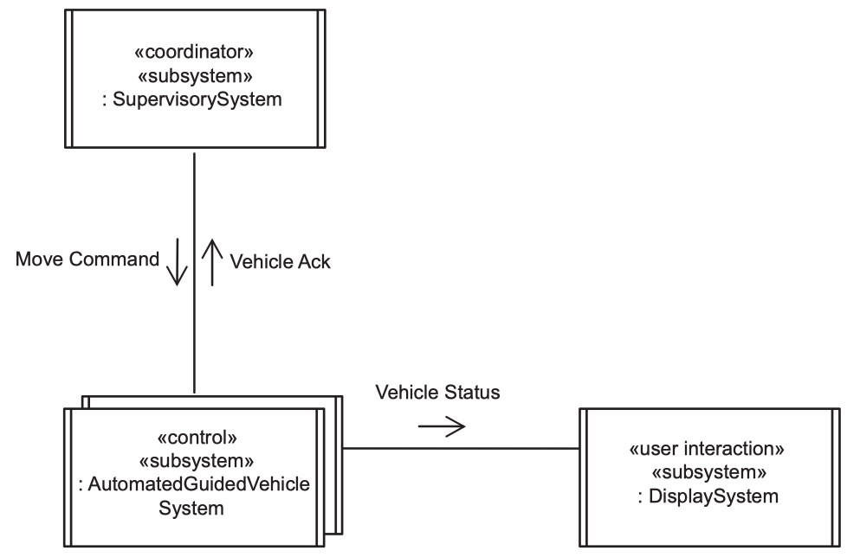
Subsystem Structuring Criteria Control Subsystem
A control subsystem controls a given part of the system. The subsystem receives its inputs from the external environment and generates outputs to the external environment.
A control subsystem is often state-dependent, in which case it includes at least one state-dependent control object.
In this example, AutomatedGuidedVehicleSystem will control the physical motor component after receiving signal from SupervisorySystem.

Slide 21
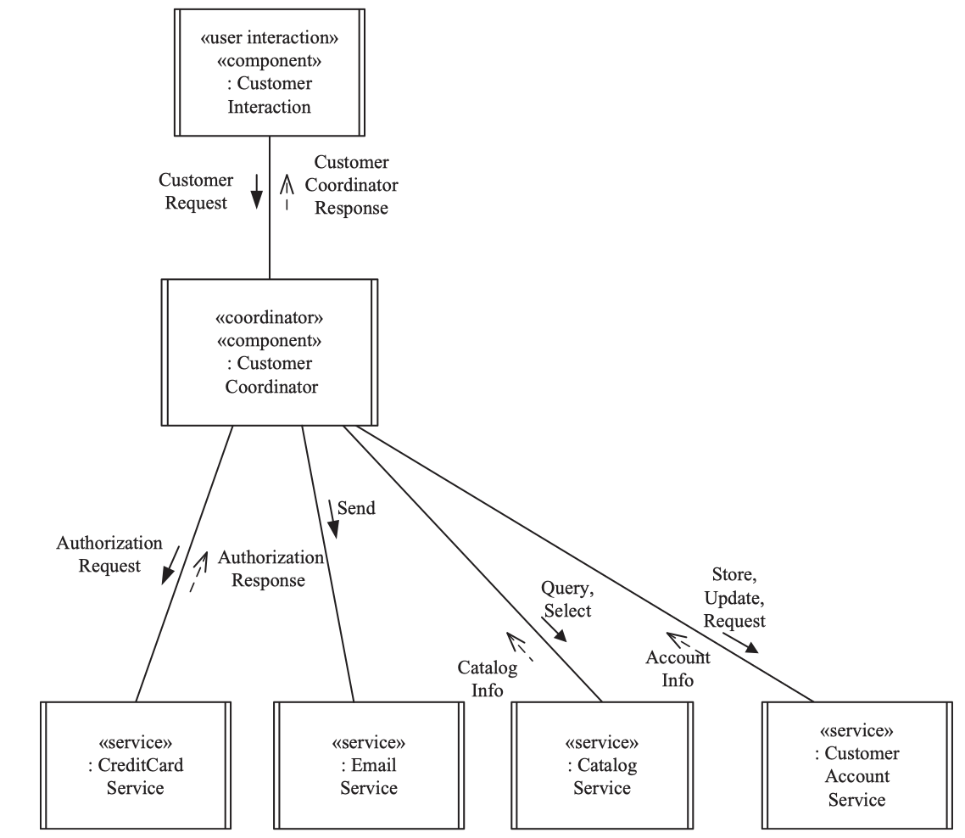
Subsystem Structuring Criteria Coordinator Subsystem
Coordinator subsystems coordinate the execution of other subsystems, such as control subsystems or service subsystems.
This is a mandatory subsystem when to coordinating tasks are relatively complex such as deciding workflow for control subsystems or coordinating services in service-oriented architectures.
In this example, CustomerCoordinator has to communicate with multiple services to serve different kinds of request from Customer

Slide 22
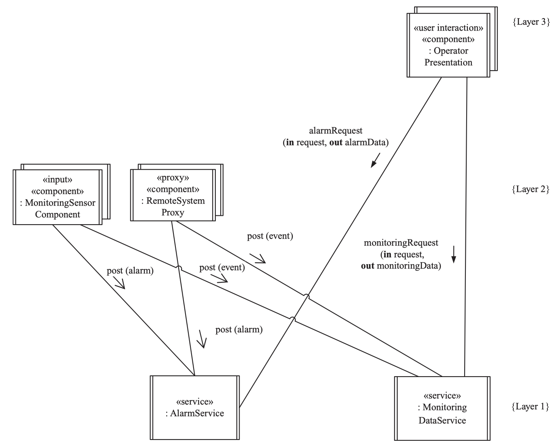
Subsystem Structuring Criteria Input/Output Subsystem
An input, output, or input/output subsystem is a subsystem that performs input and/or output operations on behalf of other subsystems.
Can be designed to be relatively autonomous.
In this example, the MonitoringSensorComponent is an input subsystem which receiving data from multiple sensors.

Slide 23
Decisions about Message Communication between Subsystems
In the transition from the analysis model to the design model, one of the most important decisions relates to what type of message communication is needed between the subsystems.
A second related decision is to determine more precisely the name and parameters of each message.
In design modeling, a decision has to be made about the precise semantics of message communication, such as whether message communication will be synchronous or asynchronous.
The aforementioned decisions concerning asynchronous and synchronous communication are formalized into architectural communication patterns.
Notes:
Aforementioned: đã nói ở trên

Slide 24
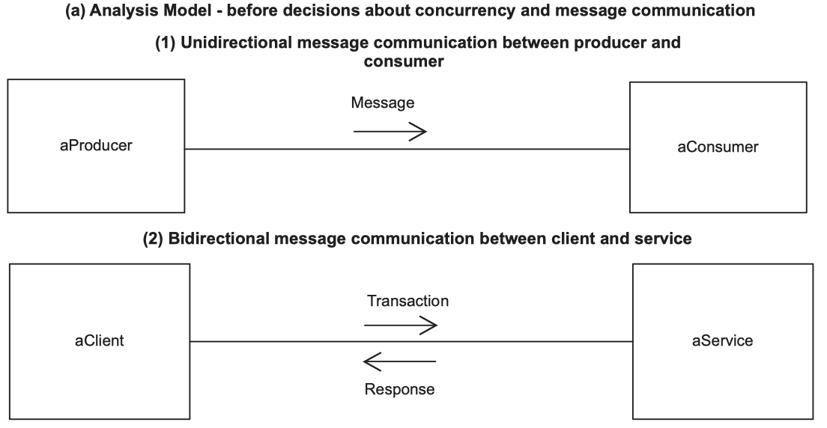
Decisions about Message Communication between Subsystems
Message communication between two subsystems can be unidirectional or bidirectional
Notes:
Aforementioned: đã nói ở trên

Slide 25
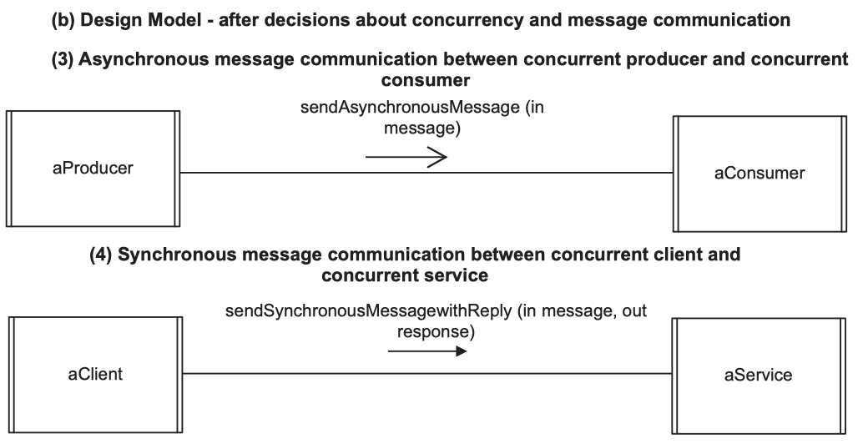
Decisions about Message Communication between Subsystems
Figure below shows the result of two design decisions.
First, the four analysis model objects are designed as concurrent
Second, the design decision is made about the type of message communication between the subsystems.
asynchronous message communication between the producer & consumer,
synchronous message communication between the client and service
the precise name and parameters of each message are determined.
Notes:
Aforementioned: đã nói ở trên

Slide 26


